Slide 1
Handwritten Digit Recognition
Presented by
Partha Pratim Mazumder
Monuar Hossain
Istiak Ahmed
Muhammad Montasir Bin M Rahman
Md. Jahidul Islam
Session: 2016-17.
Submitted to
A.R.M. Mahmudul Hasan Rana
Assistant Professor
Noakhali Science and Technology University

Slide 2
Introduction
Automatic handwritten recognition is of great academic and commercial interest.
There are many uses of handwritten digit recognition such as post offices use them to sort letters, banks use them to read personal checks.
MNIST(LeCum et al. 1998) is the most widely used benchmark for isolated handwritten digit recognition.
Convolutional neural networks(CNN) achieved a record-breaking 0.40% error rate(Simard et al.2003).
In this project we are hopeful to develop a Convolutional Neural Network to recognize different types of handwritten digit with the help of CENPARMI , CEDAR,MNIST dataset.

Slide 3
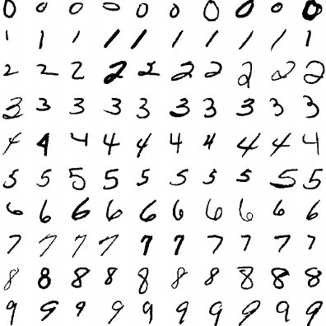
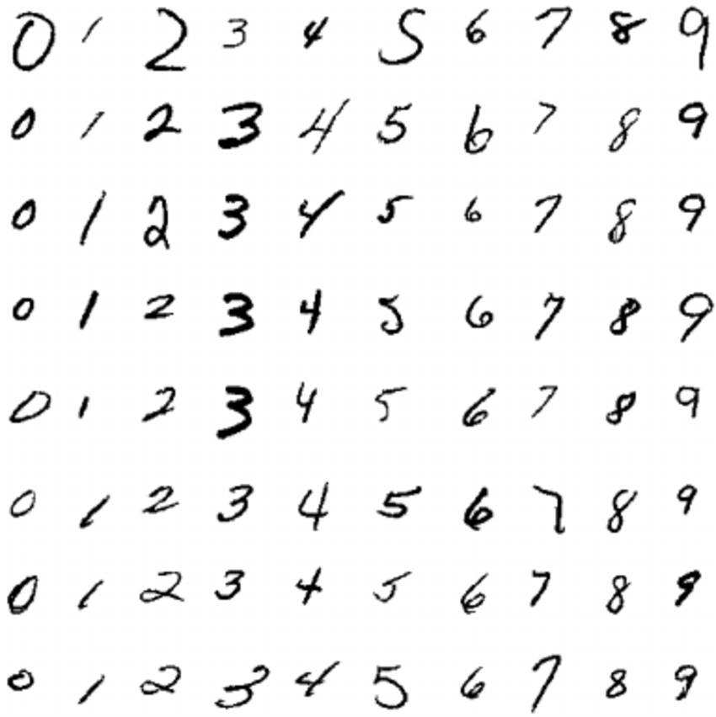
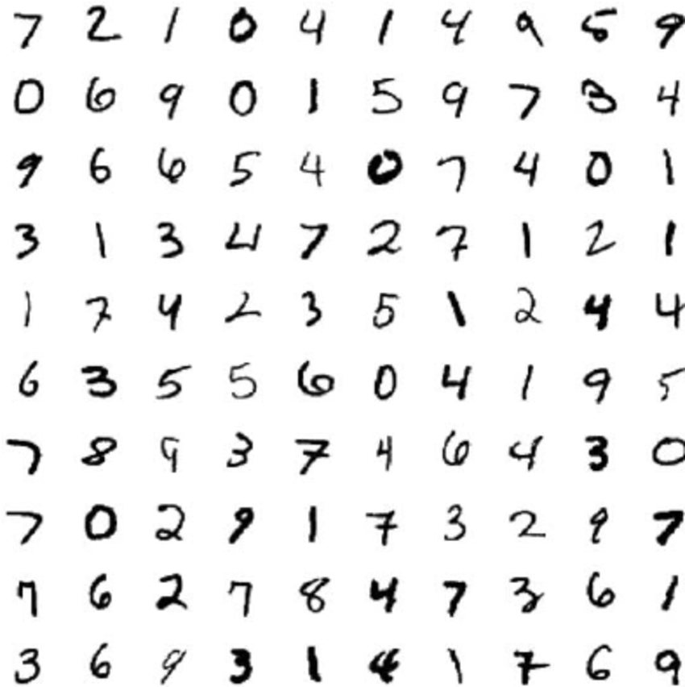
Fig 1:Sample of MNIST dataset
Fig 2:Sample of CENPARMI dataset
Fig 3:Sample of CEDAR dataset

Slide 4
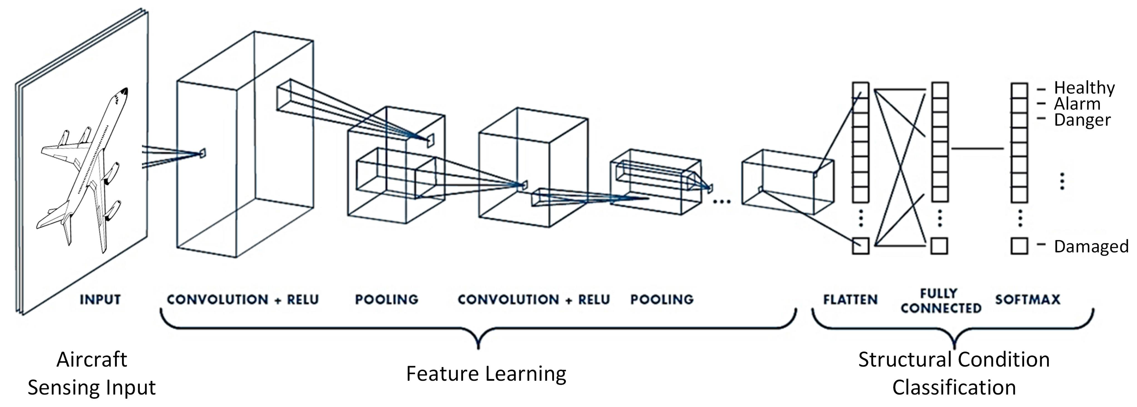
The Classifier
We hope to use CNN based classifier to accomplish the task. It is comprised of one or more convolutional layers and then followed by one or more fully connected layers in a standard multilayer neural network.

Slide 5
Related works
Pal and chaudhuri proposed a [1] new method for feature extraction for bangla digit recognition using Automatic Handwritten numerals.
Surinta et al. [2] proposed a system using a set of features such as the contour of the handwritten image computed using 8-directional codes,
Ciregan and Meier [3] applied multicolumn CNNs to Chinese character classification

Slide 6
How CNN image classifier work?
Convolution + ReLU: Convolution layer serves as neural networks filter. This layer also provides feature mapping, learning the parameters of such maps and how the patterns are detected. Here the activation function is ReLU(Rectified Linear Unit) which provides the linearity of the model.
Pooling: We will do specific type of pooling max pooling where the kernel extracts the maximum value of the area it convolves.
Flattening: In this layer we use the data pooled from previous layer and convert into a 1-dimensional array for inputting it to the next layer.
Full Connection :Here, previous layer inputs are connected together.
Softmax: Used as the activation function for multi-class classification problem where class membership is required on more than two class levels.

Slide 7
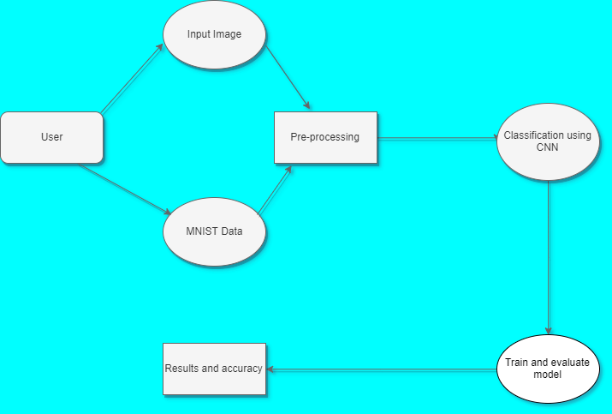
Flowchart for the work

Slide 8
Setting the system with libraries
Before we actually build the model we need right libraries and frameworks to be installed. We are going to use Google Colab to create an environment where we can run our model. Google Colab is simple to use and it uses google server to run the models and we can access free GPU and TPU for faster process. Important libraries we will use are-
Tensorflow: Python library that supports many classification and regression algorithms for deep learning and neural network
Numpy: Python library that can provide n-dimensional arrays.
Matplotlib: Visualization library that can use for 2D plot of arrays.
Keras: Open source python library for developing deep neural network models.
Seaborn: Plotting library that offers simple interface, simple defaults for plots needed for machine learning.

Slide 9
Steps to develop the model
Import the libraries and load the dataset.
Preprocess the data
Create the model
Train the model
Evaluate the model
Predict the digit for input values.

Slide 10
Conclusion
We are hoping to increase the models accuracy up to 98-99% and keep the model light weighted.
Our future work can be included as combining both Bangla digits and English digits dataset so that we can get a better model and predict both category digits with ease.

Slide 11
References
U. Pal and B. Chaudhuri, “Automatic recognition of unconstrained off-line Bangla handwritten numerals,” in Proceedings of Advances in Multimodal Interfaces–ICMI 2000, pp. 371–378, Springer, Beijing, China, October 2000.View at: Google Scholar
N. Das, R. Sarkar, S. Basu, M. Kundu, M. Nasipuri, and D. K. Basu, “A genetic algorithm based region sampling for selection of local features in handwritten digit recognition application,” Applied Soft Computing, vol. 12, no. 5, pp. 1592–1606, 2012.
D. Ciregan and U. Meier, “Multi-column deep neural networks for offline handwritten Chinese character classification,” in Proceedings of 2015 International Joint Conference on Neural Networks (IJCNN), pp. 1–6, IEEE, Killarney, Ireland, July 2015.

Slide 12


